Slide 1
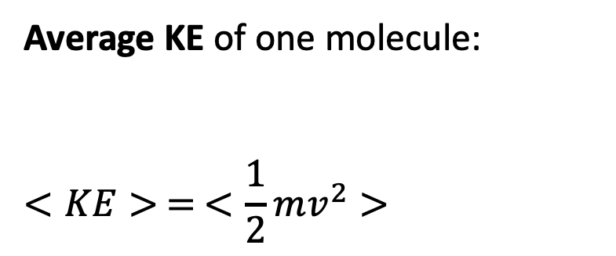
Average kinetic energy
Average KE of one molecule:
$$<KE> = <\frac{1}{2}mv^{2}>$$

Slide 2
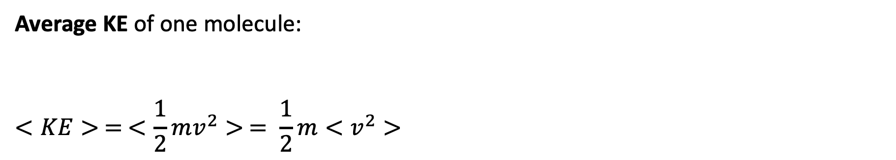
Average kinetic energy
Average KE of one molecule:
$$<KE> = <\frac{1}{2}mv^{2}> = \frac{1}{2}m<v^{2}>$$

Slide 3
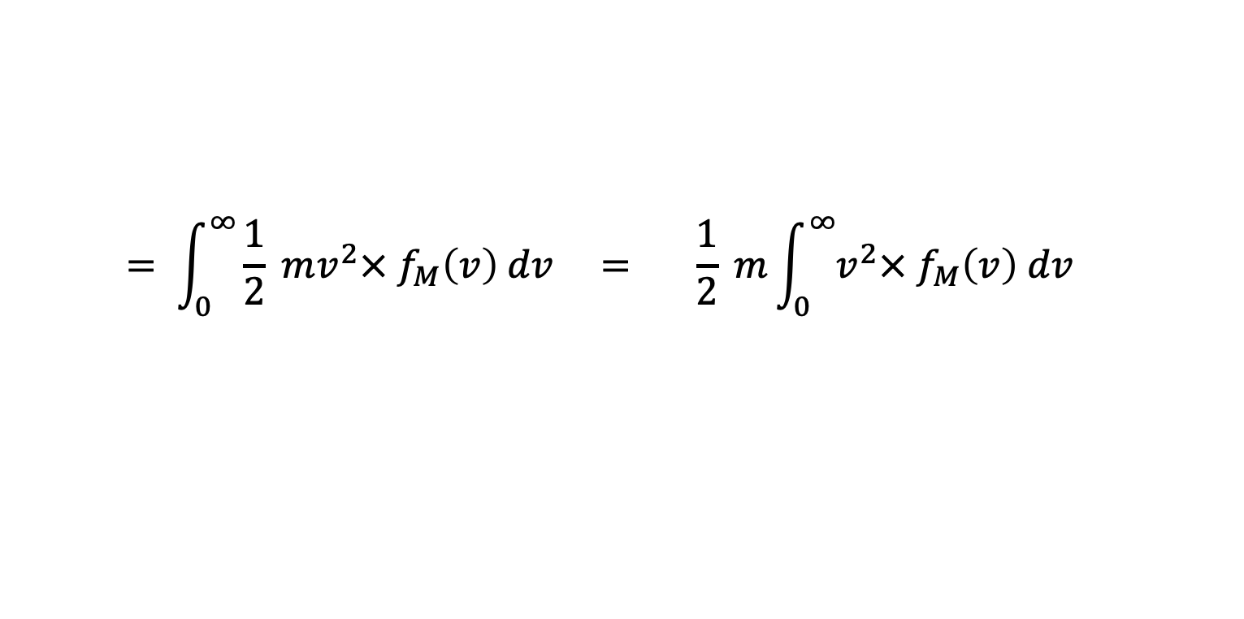
Average kinetic energy
Average KE of one molecule:
$$<KE> = <\frac{1}{2}mv^{2}> = \frac{1}{2}m<v^{2}>$$
$$= \int_{0}^{∞}{\frac{1}{2} mv^{2}× f_{M}\left(v\right) dv} = \frac{1}{2} m\int_{0}^{∞}{v^{2}× f_{M}\left(v\right) dv}$$

Slide 4
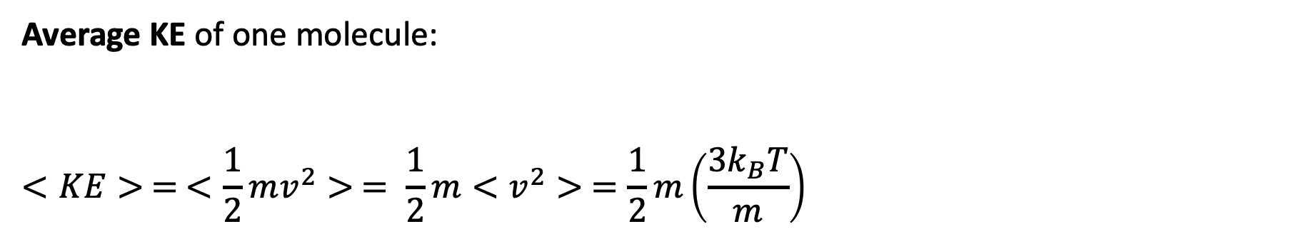
Average kinetic energy
Average KE of one molecule:
$$<KE> = <\frac{1}{2}mv^{2}> = \frac{1}{2}m<v^{2}> =\frac{1}{2}m\left(\frac{3k_{B}T}{m}\right)$$

Slide 5
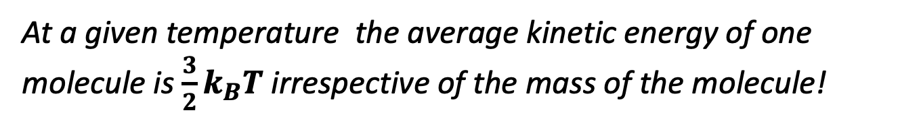
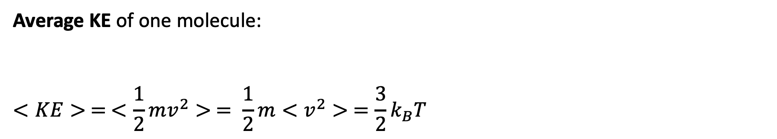
Average kinetic energy
Average KE of one molecule:
$$<KE> = <\frac{1}{2}mv^{2}> = \frac{1}{2}m<v^{2}> =\frac{3}{2}k_{B}T$$
At a given temperature the average kinetic energy of one molecule is $\frac{3}{2}k_{B}T$ irrespective of the mass of the molecule!

Slide 6
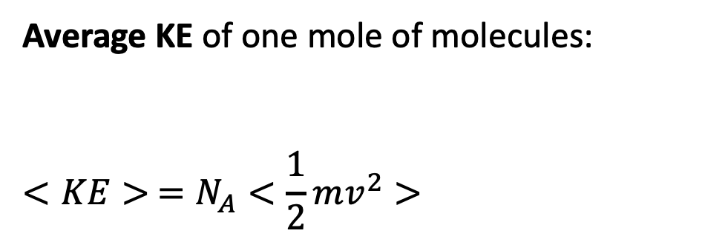
Average kinetic energy
Average KE of one mole of molecules:
$$<KE> =N_{A}<\frac{1}{2}mv^{2}>$$
Pretend there are 6.02 x 10²³ of these

Slide 7
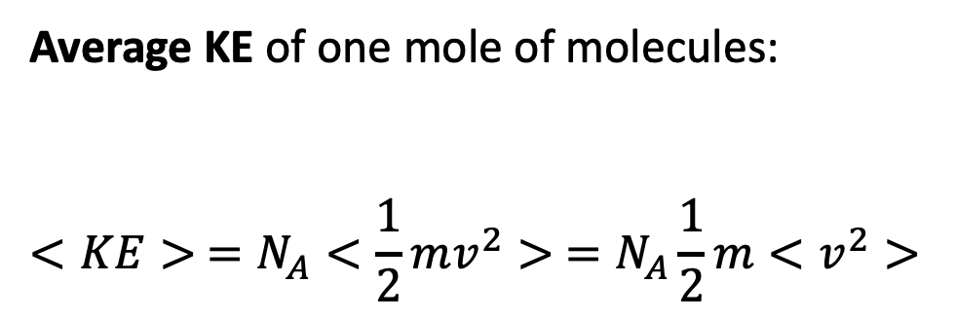
Average kinetic energy
Average KE of one mole of molecules:
$$<KE> =N_{A}<\frac{1}{2}mv^{2}> =N_{A}\frac{1}{2}m<v^{2}>$$
Pretend there are 6.02 x 10²³ of these

Slide 8
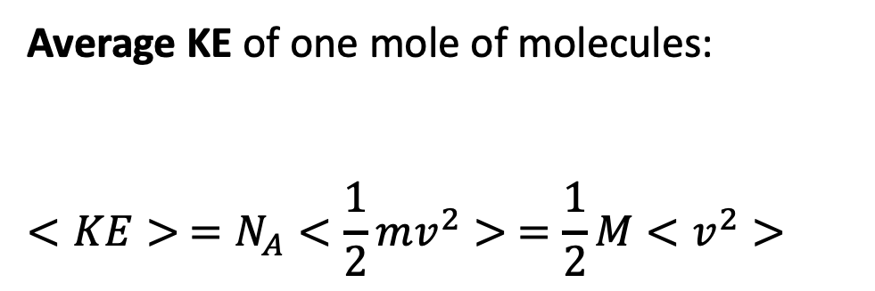
Average kinetic energy
Average KE of one mole of molecules:
$$<KE> =N_{A}<\frac{1}{2}mv^{2}> =\frac{1}{2}M<v^{2}>$$
Pretend there are 6.02 x 10²³ of these

Slide 9
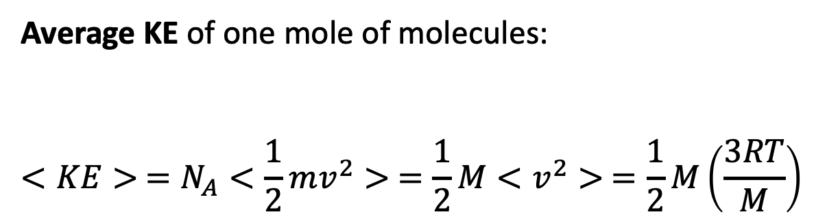
Average kinetic energy
Average KE of one mole of molecules:
$$<KE> =N_{A}<\frac{1}{2}mv^{2}> =\frac{1}{2}M<v^{2}> =\frac{1}{2}M\left(\frac{3RT}{M}\right)$$
Pretend there are 6.02 x 10²³ of these

Slide 10
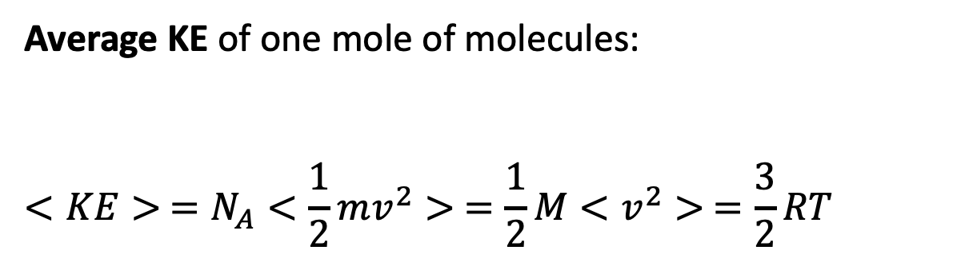
Average kinetic energy
Average KE of one mole of molecules:
$$<KE> =N_{A}<\frac{1}{2}mv^{2}> =\frac{1}{2}M<v^{2}> =\frac{3}{2}RT$$
Pretend there are 6.02 x 10²³ of these

Slide 11
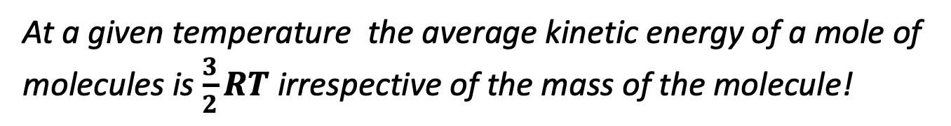
Average kinetic energy
Average KE of one mole of molecules:
$$<KE> =N_{A}<\frac{1}{2}mv^{2}> =\frac{1}{2}M<v^{2}> =\frac{3}{2}RT$$
Pretend there are 6.02 x 10²³ of these
At a given temperature the average kinetic energy of a mole of molecules is $\frac{3}{2}RT$ irrespective of the mass of the molecule!

Slide 12
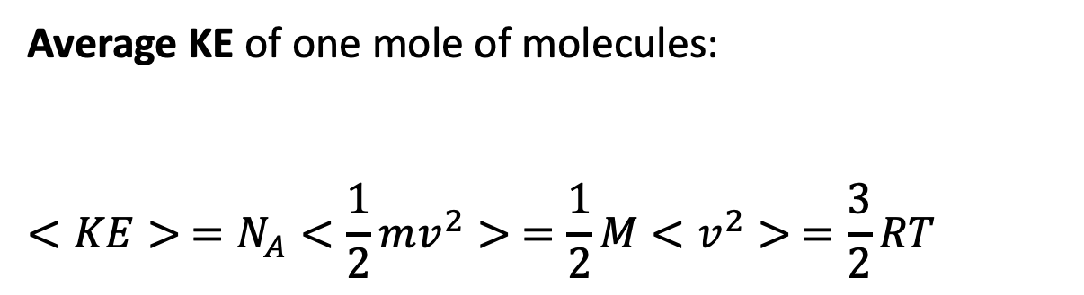
Average kinetic energy
Average KE of one mole of molecules:
$$<KE> =N_{A}<\frac{1}{2}mv^{2}> =\frac{1}{2}M<v^{2}> =\frac{3}{2}RT$$
Pretend there are 6.02 x 10²³ of these
So the question arises, are collisions at room temperature able to break:
Covalent bonds?
van der Waals bonds (what we’ve called “stickiness”)?

Slide 13
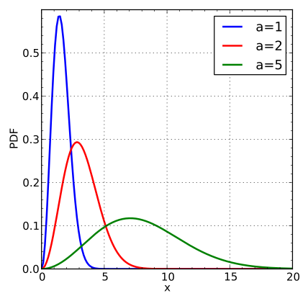
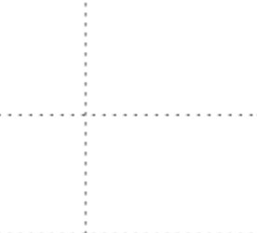



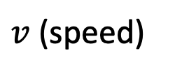
Another way to look at the ordering of the c’s
$c^{∗}=$ most probable $=α×{\left(\frac{RT}{M}\right)}^{1/2}$
$\overline{c} = <v> =α′×{\left(\frac{RT}{M}\right)}^{1/2}$
$c= <v^{2}>^{1/2}=α′′×{\left(\frac{RT}{M}\right)}^{1/2}$
$\tilde{c}= <v^{3}>^{1/3}=α′′′×{\left(\frac{RT}{M}\right)}^{1/2}$
But what are the numerical values of $α$, $α^{′}$, etc.?
(It must be that $α<α^{′}<α^{′′}<α′′′$, right?)
$$f_{M}$$
$v$ (speed)
$$c^{∗}<\overline{c}<c<\tilde{c}$$

